Slide 1
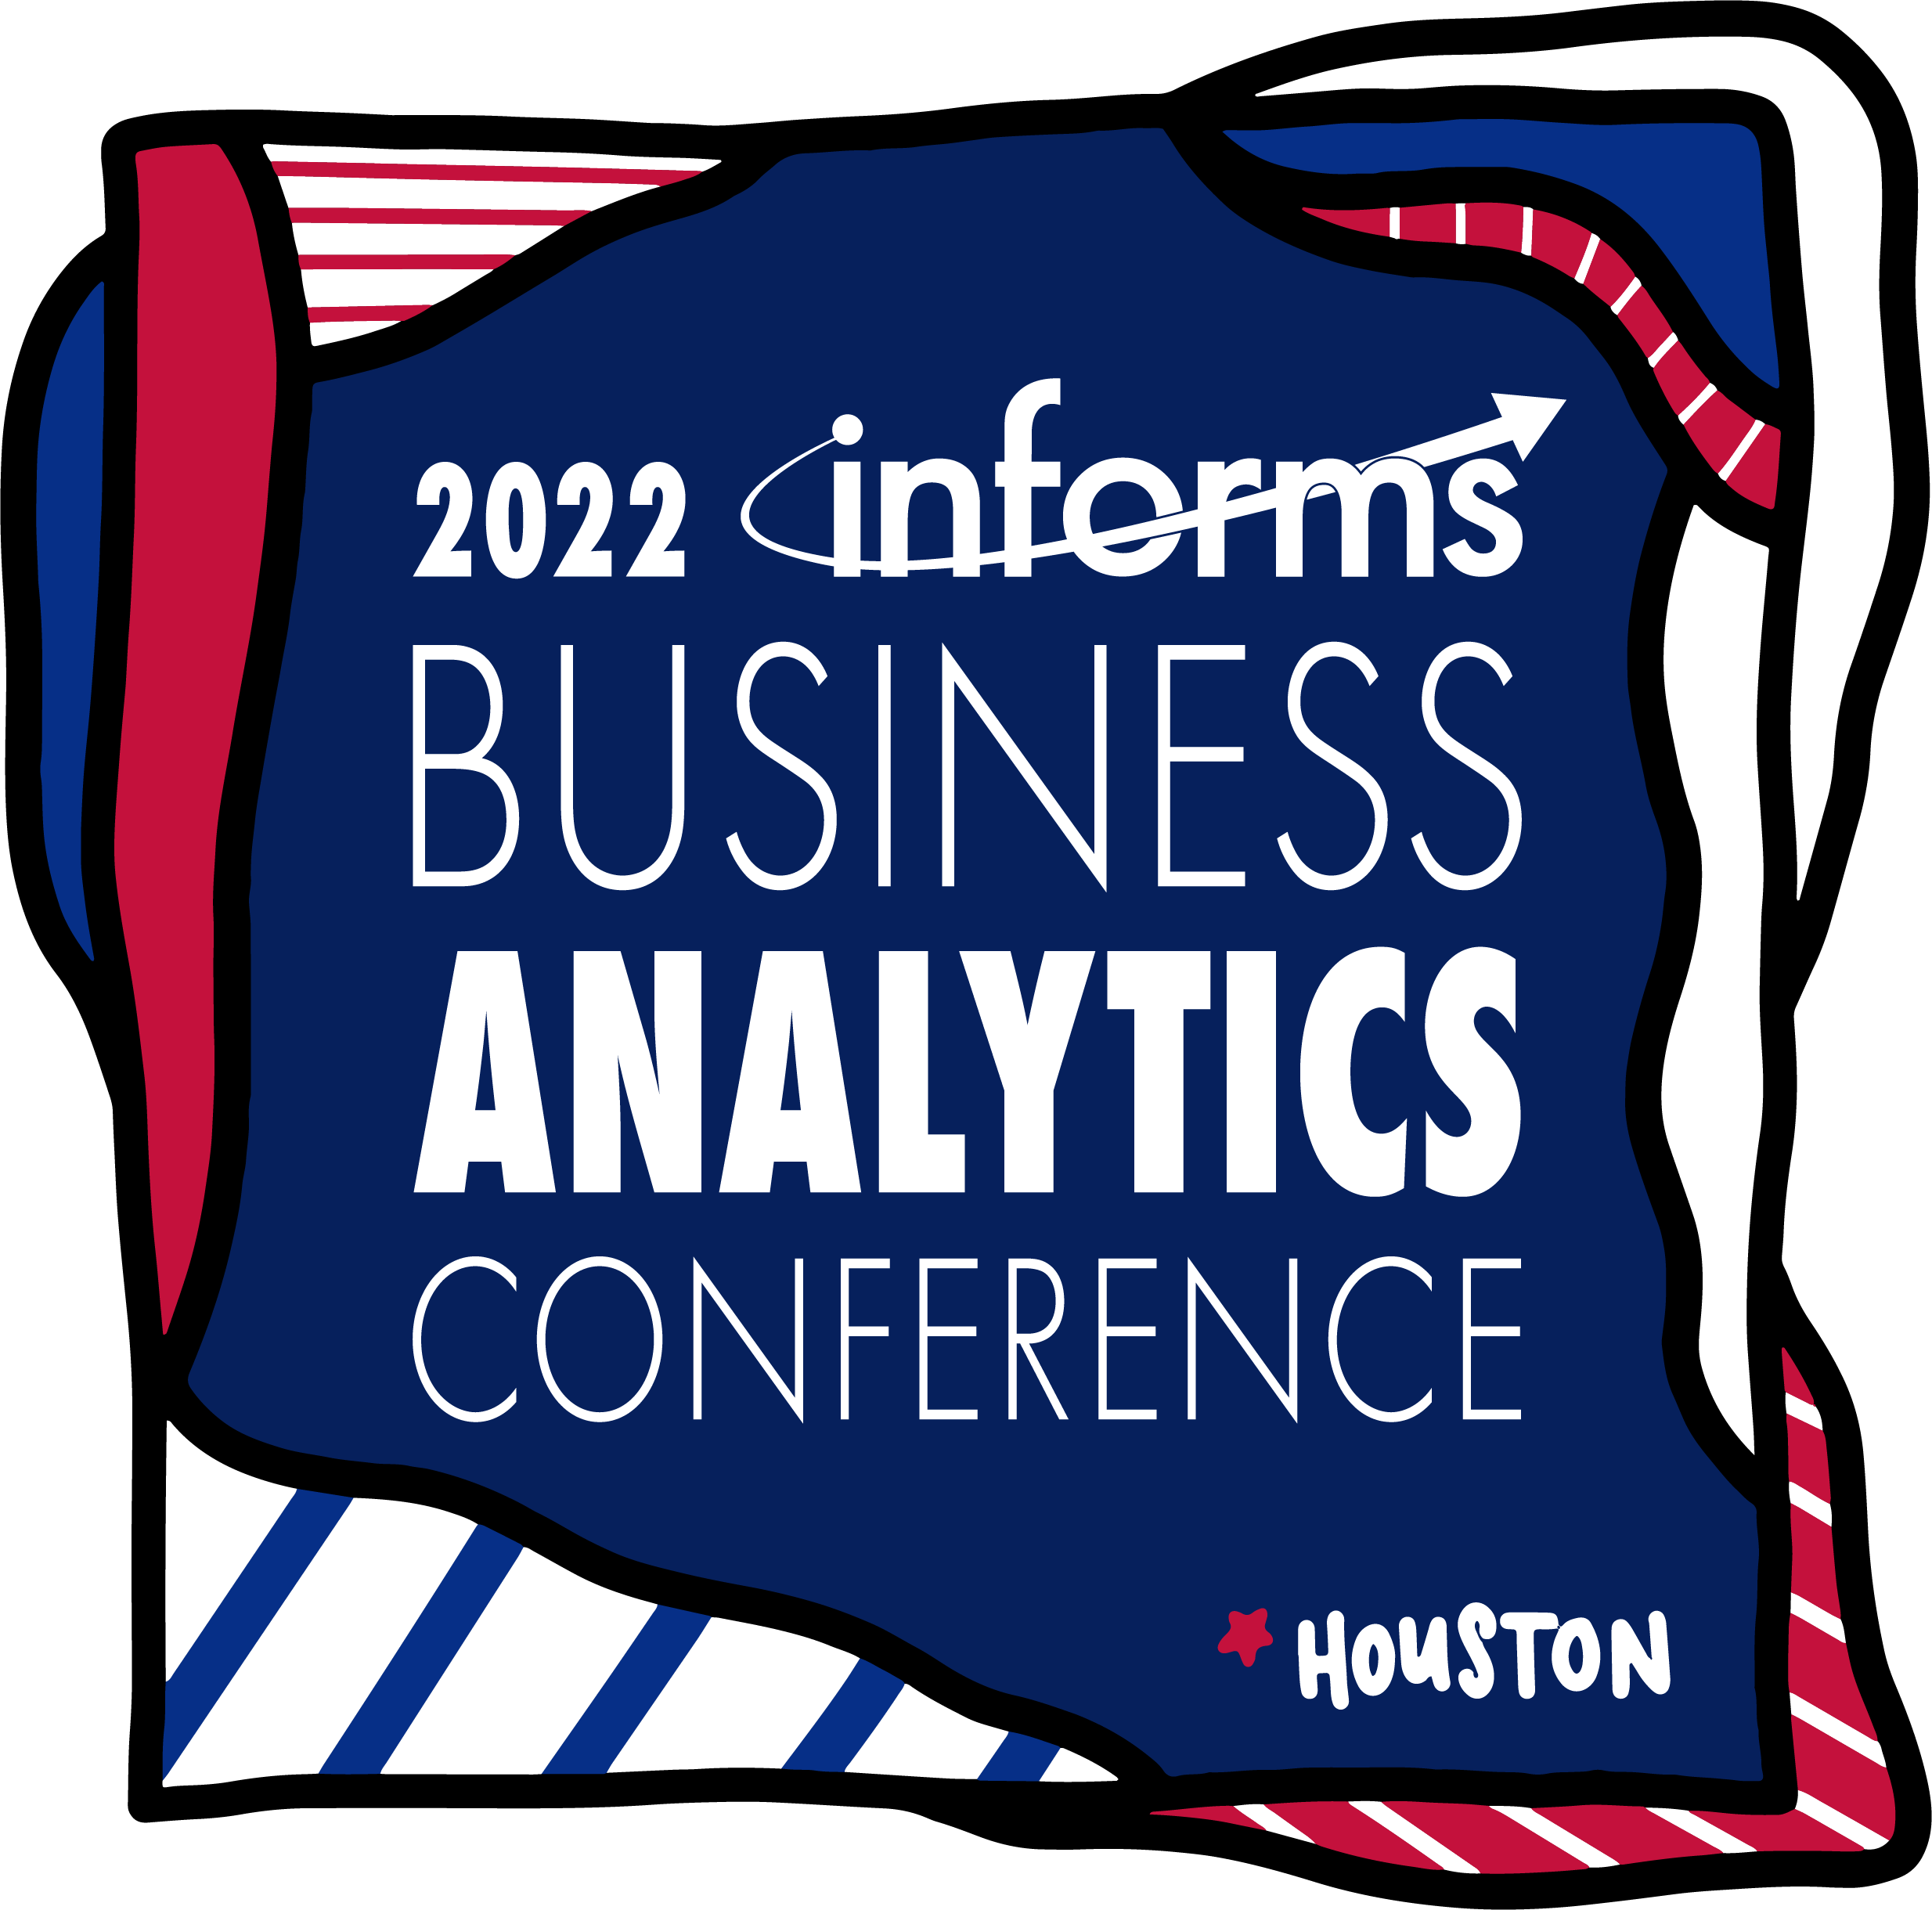


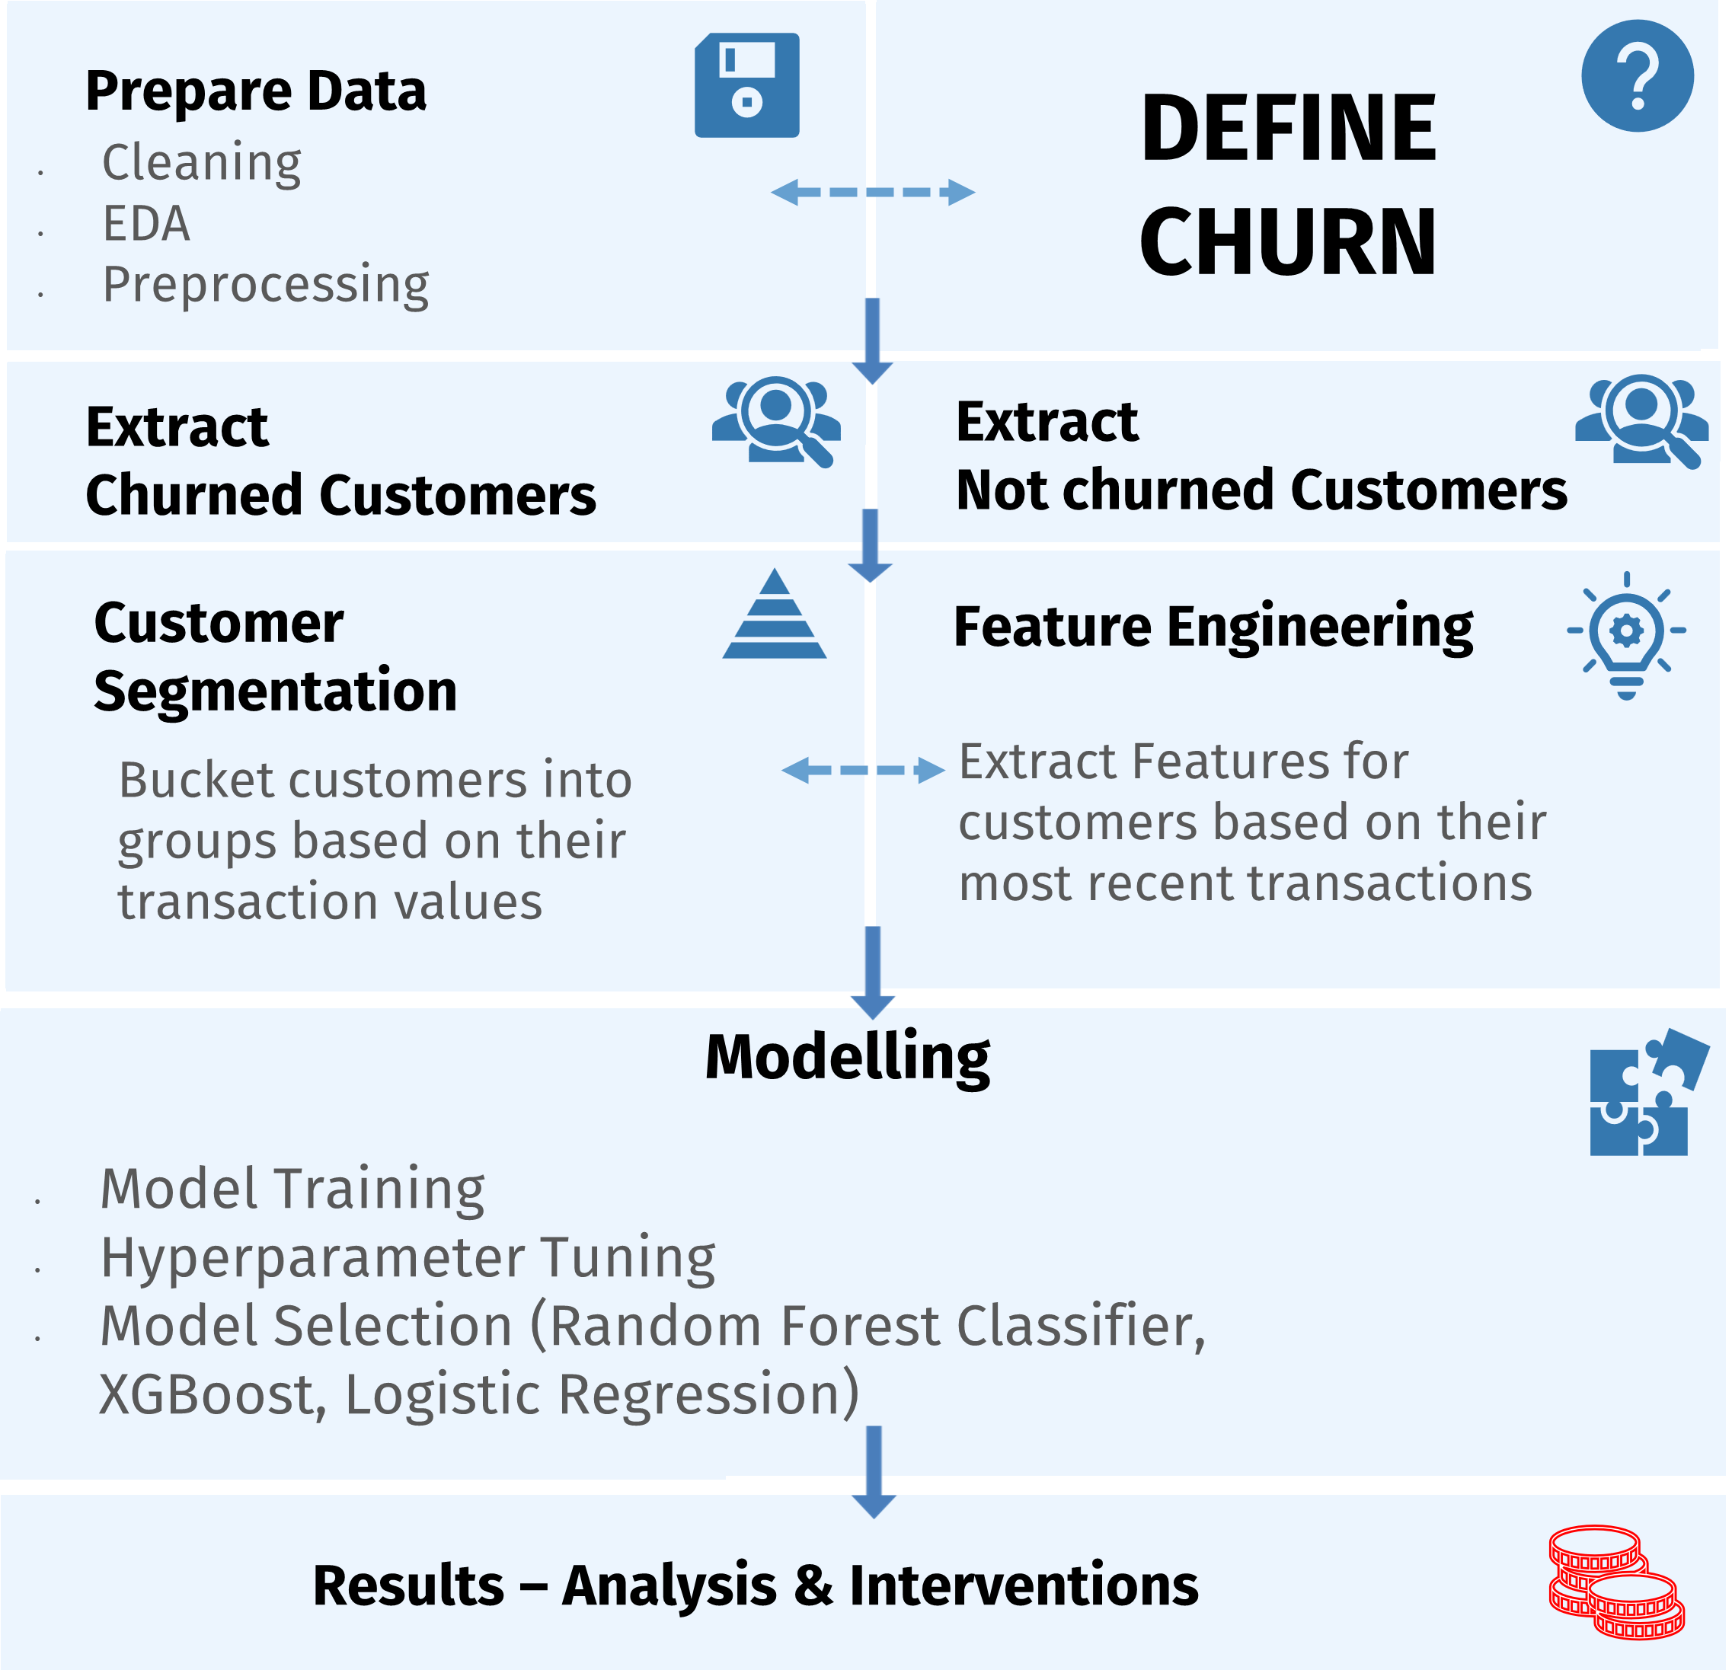
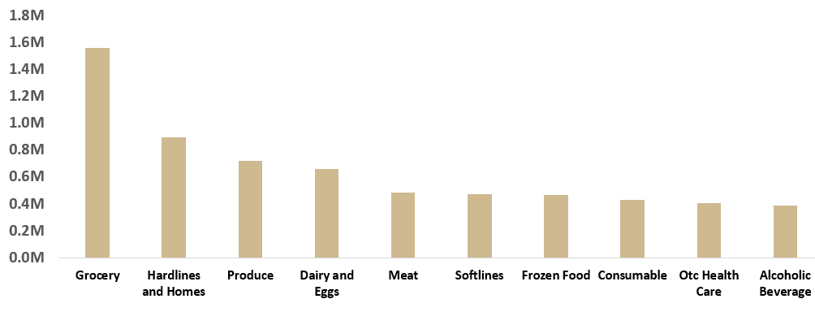
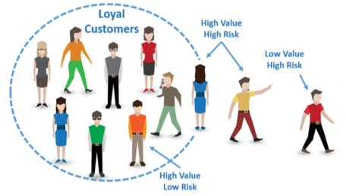
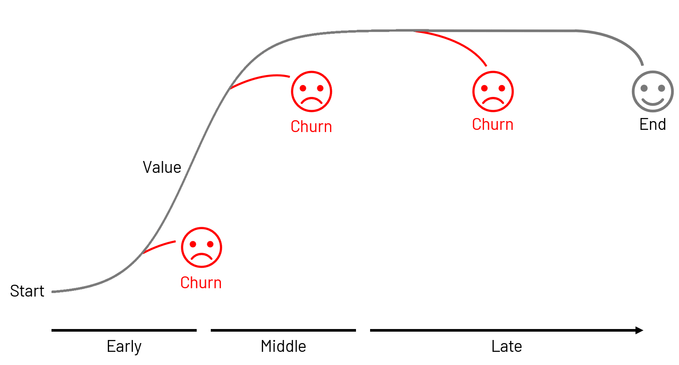
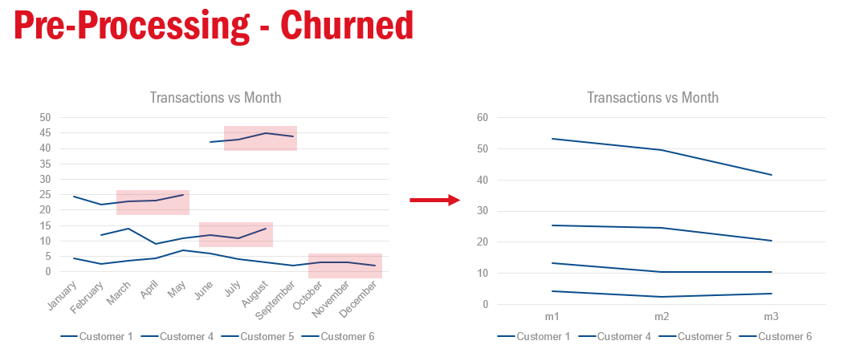
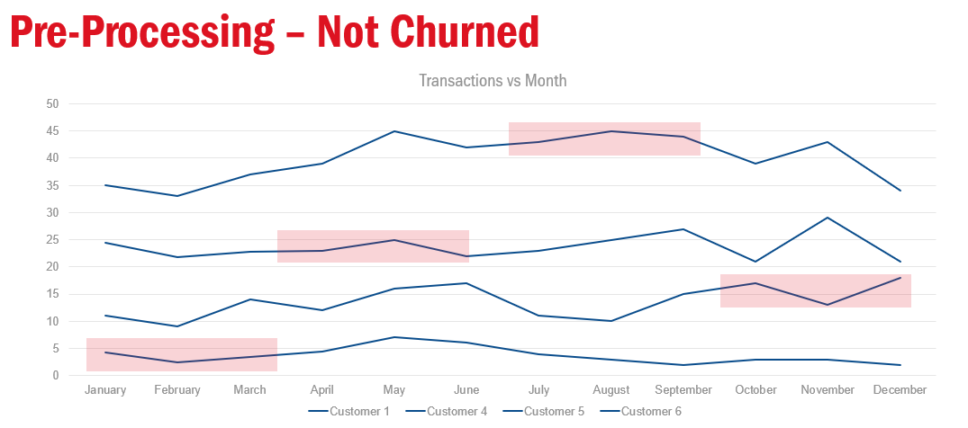

Customer Segmentation, Churn Prediction and its implications using ML
Iyer Vinod, Joshi Mrinmayee, Kothari Adithya, Sharma Siddhant, Singh Sudipta, Taparia Raghav, Yang Wang
Purdue University, Krannert School of Management
iyer108@purdue.edu; kothari8@purdue.edu; joshi155@purdue.edu; sharm486@purdue.edu; singh912@purdue.edu; rtaparia@purdue.edu, yangwang@purdue.edu
ABSTRACT
LITERATURE REVIEW
STATISTICAL RESULTS
EXPECTED IMPACT
Customers enrolled in loyalty programs are the most important customers to national scale retailers, who are expected to have high repeat purchase rates. Consequently, losing these customers would result in a significant revenue impact. Our study is focused on predicting who are the customers that are likely to churn and when they are expected to churn within their customer cycle. For successful results, this study required identifying current high-value customers, establishing behavioral patterns and KPIs, and training our ML model to predict customers that are expected to churn within a set duration in time.
Various supervised algorithms like Logistic Regression. Naïve Bayes’, Decision Tree, Random Forest, and Extreme gradient boosting have been used to predict churn.. Also, RFM analysis, K-means clustering have been used previously to segment users into churned and not churned customers.
The number of transactions in the month M1 (month before the churn) is the crucial variable in determining churn. Therefore, it can be utilized to formulate strategies of intervention to increase engagement
After the users at risk of churning have been marked, the future step is to strategize the marketing actions required to improve the possibilities of the churn-probable users staying engaged. Moreover, marketing costs can be optimized by providing promotions and coupons to only valuable customers
Average monthly revenue for churned customers is highest for Grocery sales ($1.6M) followed by Hardlines & Home ($0.9M). Overall, $6.9M can be saved through churn prediction in top ten product categories
A. Comparing different algorithms for accuracy
 | NB | LR | DT | RF | GB | BPN
Annapurna et al., 2017
Ali Tamaddoni Jahromi et al., 2014
Abou el Kassem et al., 2020
T.Vafeidas et al., 2020
Our Study, 2021
INTRODUCTION
Why is Churn important? Data from a national chain retailer shows that
70% of sales generated from engaged customers (30% of total customers)
Table 1. Literature Summary
METHODOLOGY
C. Average Monthly Revenue Lost by category
A business can generate more revenue by increasing customer loyalty, upselling existing customers, or gaining more new customers. Almost all revenue-generation methods involve an initial cost, and research shows that gaining new customers is more expensive than keeping existing ones. Thus, churn prediction is a useful tool for determining the actual return on investment for a certain product or service. Even though all businesses are at risk of losing customers, conducting an attrition analysis significantly reduces the risk. As soon as the churn-probable customers are identified, the next step is to strategize the marketing actions needed to keep them. The focus here is the retail industry.
•Added variables defining last leg of customer’s journey
•Incorporated importance of Grocery shopping in predictor variable
•Added variables to define customer experience at supercenters
Fig 3. Model Results
Out of the 5 classification models, Gradient boost performed the best with 93% accuracy. While the remaining algorithms were significantly lower, Random forest and Logistic Regression were the next best algorithms with 83% and 81% accuracy, respectively.
B. Variable Importance Score
CONCLUSIONS
Customers who have been shopping at Groceries and Staples at the stores indicate loyalty to the company
Mitigating the challenge of churning customers can increase annual revenues by 60%
The shopping patterns in the categories in the most recent 2 months would help us identify if the customer is on their way to churn or disengage
Once these shopping patterns are identified for a customer, intervention strategies can be placed to potentially mitigate the loss of X dollars in monthly sales for that customer
Fig 2. Methodology
How do we define churn? Let’s look at some scenarios - 1. Understanding the type of churn: It’s difficult to understand if a customer has churned voluntarily, silently or involuntarily.
2. What exactly constitutes a churn event? Can a customer who purchases very sporadically be labelled as a churned customer? Or can a customer who purchase consecutively in the last 3 months but did not purchase anything this month be labelled as a churned customer? The concept of ‘churn’ is very fuzzy.
3. Low Churn Rate: Considering a business is in a good shape, customer churn becomes a relatively rare event, so what constitutes churn in this case?
Churned Customers Customers who have transacted for 5 months within a 6-month timeframe and did transact for 3 consecutive months are classified as churned customers.
ACKNOWLEDGEMENTS
Not-Churned Customers Customers who have transacted at least once every month from their first transaction during the entire duration of data are classified as Not-Churned customers.
Fig 4. Importance Score
We would like to thank Professor Yang Wang and our industry partner for this opportunity, their guidance, and support on this project.
RESEARCH OBJECTIVES
What are the most important factors affecting churn?
Predict likelihood of a customer to churn
Identify red flags and initiate interventions before customer churns
The top 6 variables in descending order of importance to predict churn are shown in the figure : The month before the churn (M1 was the most important amongst the 2 months). Grocery sales and pharmacy visits were the most important while comparing different categories.

